Slide 1
API Automated Testing
For Room Manager and Pivotal Tracker

Slide 2
INTRODUCTION
What is Automation Testing?
What is REST?
What is API Testing?
What is continuous Integration?

Slide 3
INTRODUCTION
Difference BETWEEN TDD, BDD and BDT
What is the benefice to use BDT?
What is a Framework and why use it?

Slide 4
ROOM MANAGER

Slide 5
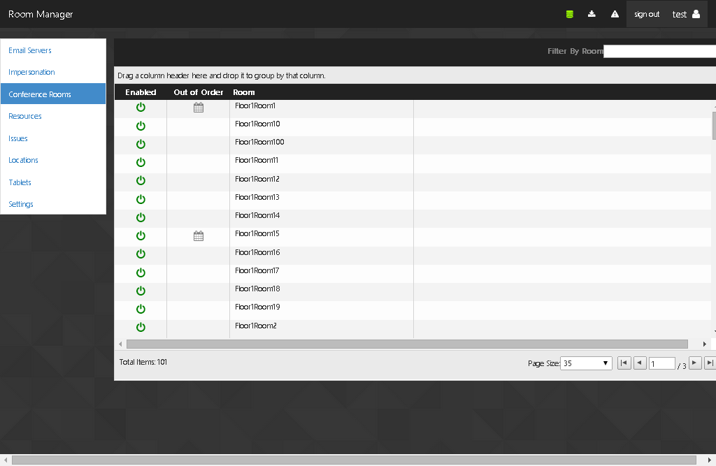

Slide 6
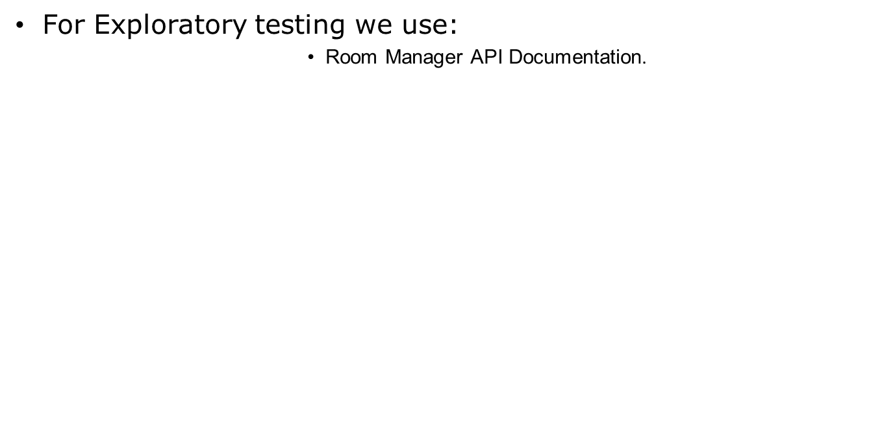

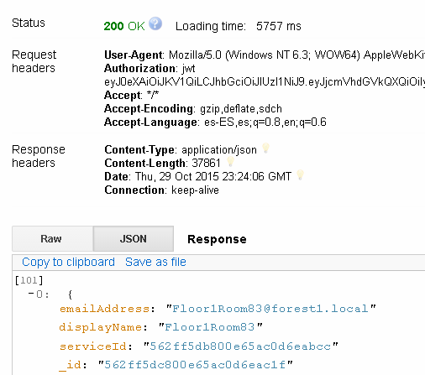
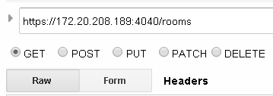
Exploratory for Room Manager API
REST CLIENT

Slide 7
Manual Test Case Smoke
Title | Smoke Test Post/Services- Verify the Post services API returns status 200
Priority | 1
Description | The Service Post/services should response with the code 200 in the request that means that the API is implemented in the end point POST/Service.
Requirements | -Have a token key to use in the authorization field -Have an Email Server where Room manager gets the Rooms -Have an Exchange server account: e.g. userName: administrator ,Password: password -A REST Client will be used for the request execution
Steps | 1. Open the REST Client Tool 2. Enter the URL of the API POST /services: https://172.20.208.189:4040/services?type=exchange 3. Check the POST option(Radio Button) 4. Introduce in the Authorization field "Authorization" word in (Authorization Form) 5. Introduce the token key e.g.(jwt eyJ0eXAiOiJKV1QiLC) 6. Introduce the credentials in Json format in the raw field e.g.({ "username": "Administrator", "password": "Clave123", "hostname": "qadev04exc04.forest1.local" }) 7. Click Send Button
Expected result | The Server Response should have the 200 status in the Response Field

Slide 8
Manual Test Case CRUD
Title | Verify that the DELETE method by Id of a meeting, removes the meeting specified.
Priority | 1
Description | This test verifies that the "DELETE meeting by Id" service of the end point /services/{:serviceId}/rooms/{:roomId}/meetings/{:meetingId} removes the meeting specified.
Requirements | A REST Client will be used for the request execution
Steps | 1. Open the REST Client Tool 2. Enter the endpoint https://172.20.208.195:4040/services/{:serviceId}/rooms/{:roomId}/meetings/{:meetingId} 3. Select the DELETE option in the tool 4. Add the basic authorization 4. Press "Send" button 5. Go to "Response" section
Expected result | The DELETE method by Id of a meeting should remove the meeting specified.

Slide 9
Framework and tools

Slide 10

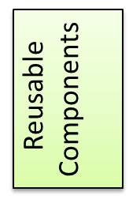
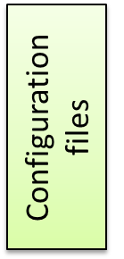


Framework Architecture
TEST CASES
APP access components
Automation Tools
System Under Test
API

Slide 11
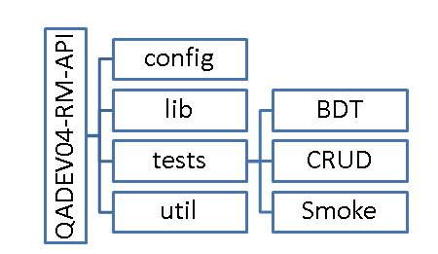
Folder Structure

Slide 12
Tools
Mocha
Superagent
Chai
Log4js
Moment
MongoDB
Xunit

Slide 13
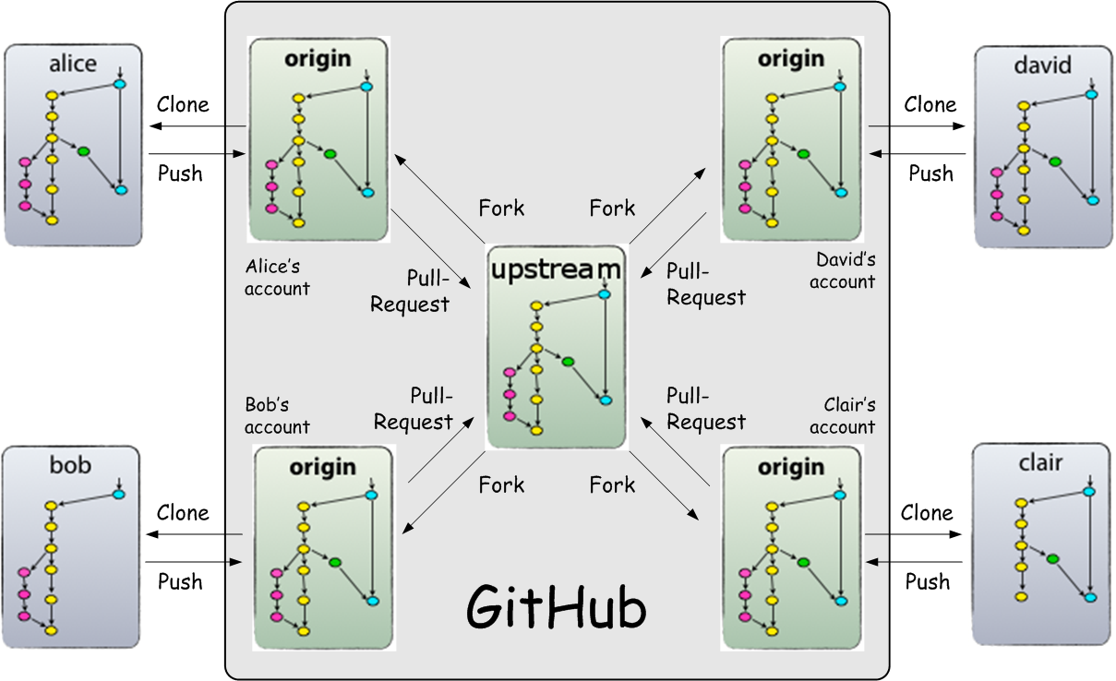
Continuous Integration

Slide 14
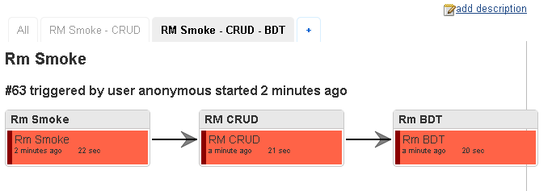
Jenkins

Slide 15
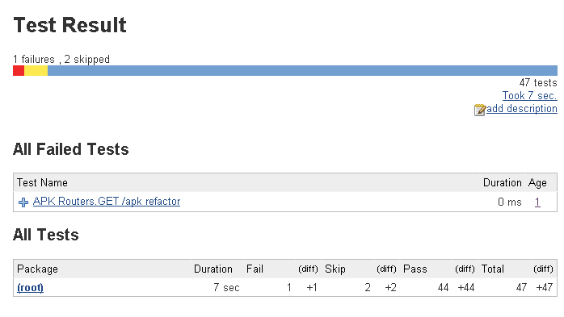
Jenkins

Slide 16
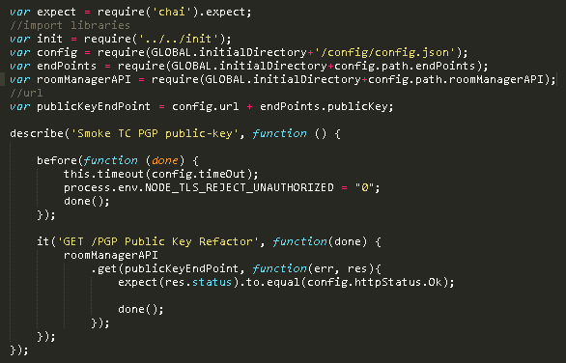
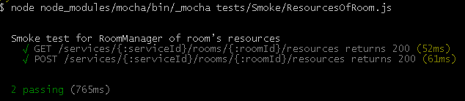
Smoke Testing

Slide 17
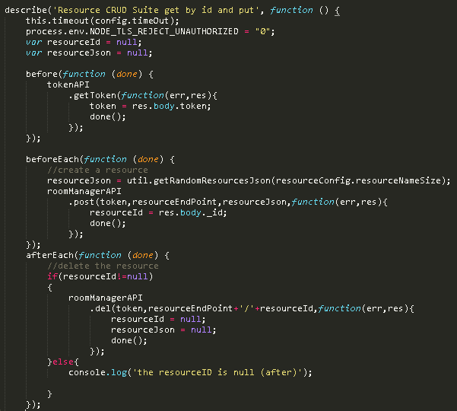
CRUD testing

Slide 18
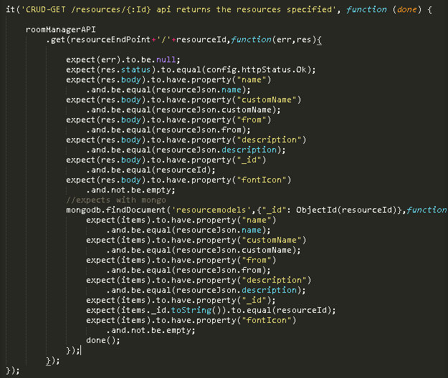
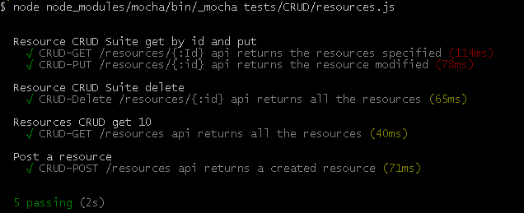

Slide 19
BDT testing
Scenario.– Create a meeting at the room with location and after delete the parent location.
Given a room with location with subLocation
when created a meeting in the subLocation
Then modify the location to subLocation
Then delete the parent location

Slide 20
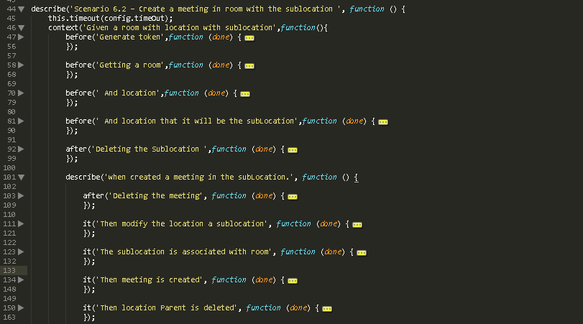

Slide 21
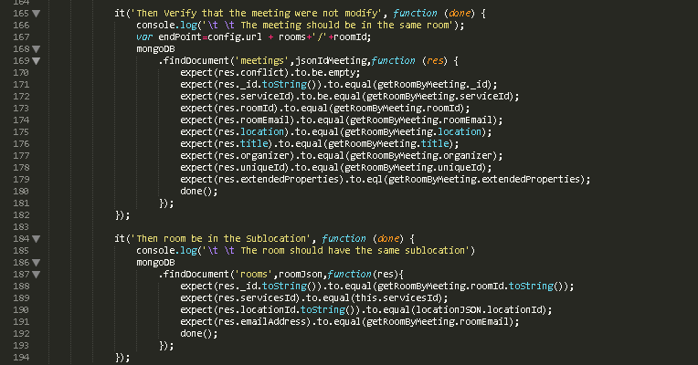

Slide 22
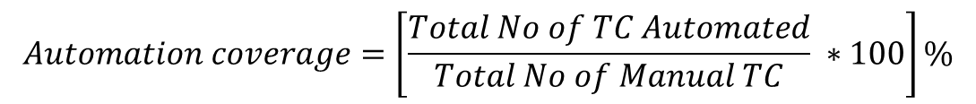

Metrics
 | Smoke test Cases automated | CRUD Test Cases automated | BDT Behavior Driven Testing (total test cases) | Finish date 10/28/2015 | Total days worked begin 10/19/2015 end date 10/28/2015 | Test Cases Automated per Day | test Case Automated per hour
test cases already automated | 47 | 45 | 28 | 120 | 9 | 13 | 2
TC Automated |  |  | Manual TC
CRUD | BDT | Total | CRUD | BDT | Total
45 | 28 | 73 | 47 | 28 | 75
 | Number | Automation | Manual
Smoke TC | 47 | 14 seg. | 3.92h
CRUD TC | 47 | 19 seg. | 7.83h

Slide 23
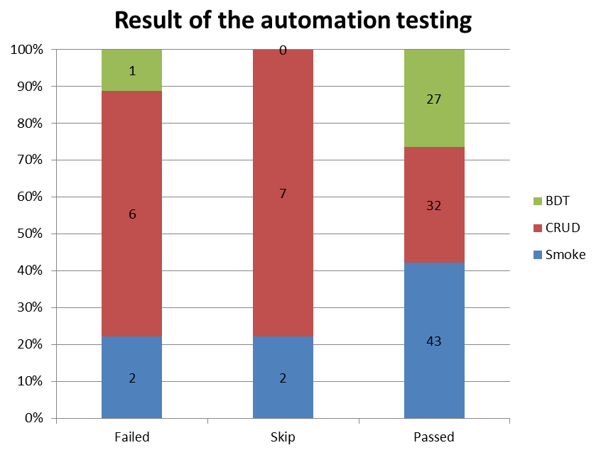
Result of the automation testing
 | Failed | Skip | Passed | Total
Smoke | 2 | 2 | 43 | 47
CRUD | 6 | 7 | 32 | 45
BDT | 1 | 0 | 27 | 28
Total |  |  |  | 123

Slide 24
Bugs Found
Issue Id | Title
BUG07147 | It's not possible associate a resource to room by API
BUG07152 | The structure of the public key returned for the API of Room Manager not is correct
BUG07148 | The PUT and DELETE for meetings do not support credentials with email by API
BUG07150 | It is not possible add an email server after to removed it
BUG07149 | Out of order POST-it is not possible to create out of order in a specific room
BUG07151 | meeting POST- It is possible to create a meeting in a room out of order
BUG07153 | Attendees route - The load time of services Attends route is more than 50 seconds

Slide 25

API Testing

Slide 26
What is Pivotal Tracker
Pivotal Tracker is a simple, story-based project planning tool that allows teams to collaborate and react instantly to real-world changes. It's based on agile software development methods, but it can be used on a variety of types of projects. Tracker frees you up to focus on getting things done, without getting bogged down, keeping your plans in sync with reality.

Slide 27
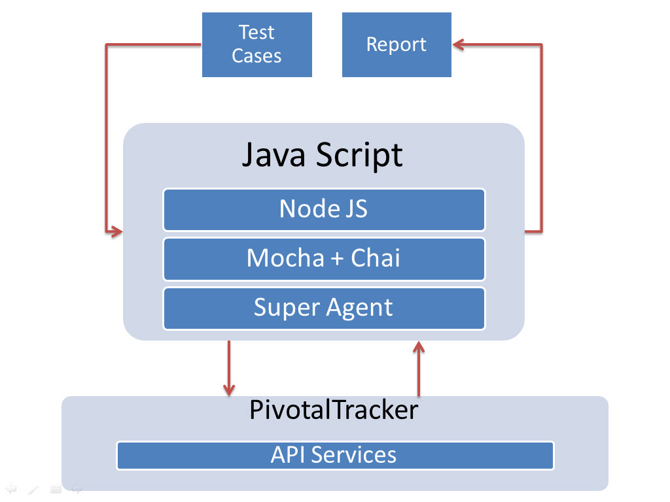
Framework

Slide 28
Test Plan
Features to be Tested
  Account
  Accounts
  Account Memberships
  Activity
  Attachments
  Iterations
  Labels
  Me
  Project
  Project Memberships
  Projects
  Stories
  Story
  Story Tasks
Features not to be Tested
  Comments
  Epic
  Epics
  Exports
  Notifications
  Project Integrations
  Project Webhooks
  Request Aggregator
  Saved Search
  Search
  Source Commits
  Workspaces

Slide 29
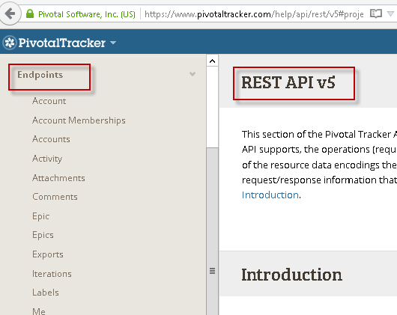
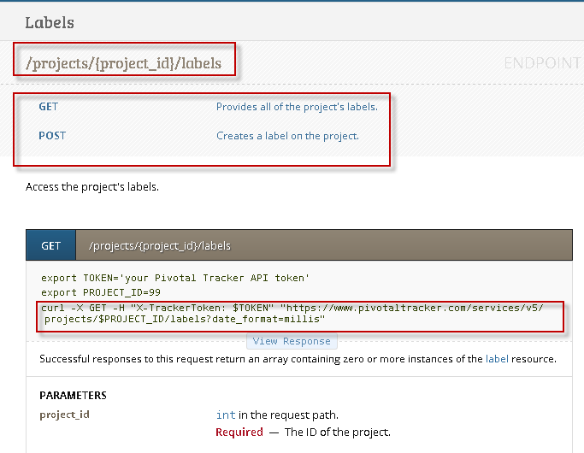
Exploratory API

Slide 30
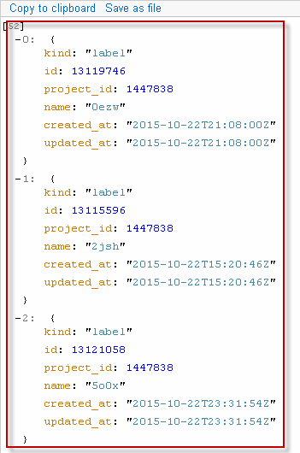
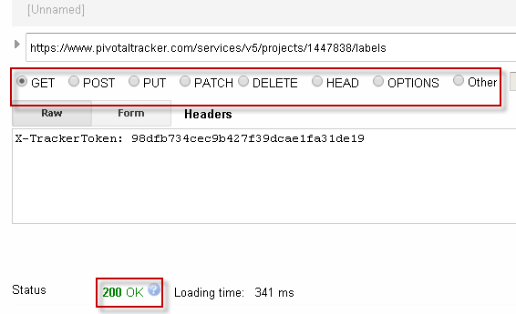
Exploratory API
REST API TOOL

Slide 31
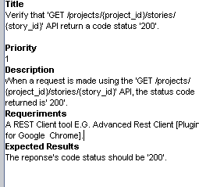
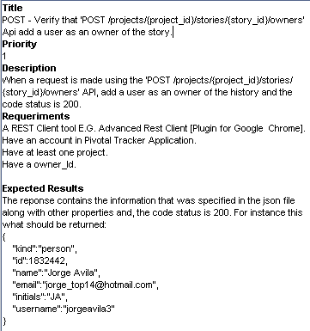
Manual Test Cases
Smoke Test Case
CRUD Test Case

Slide 32
Codding Standards
The coding standards to be used will be Google JavaScript Style Guide:
https://google.github.io/styleguide/javascriptguide.xml
Specifically:
Function Declarations within Blocks.
Method and property definitions.
Multiline string literals.
Code formatting.
Strings.
{..}
[..]
var,/**…*/
. {
;
‘text’

Slide 33
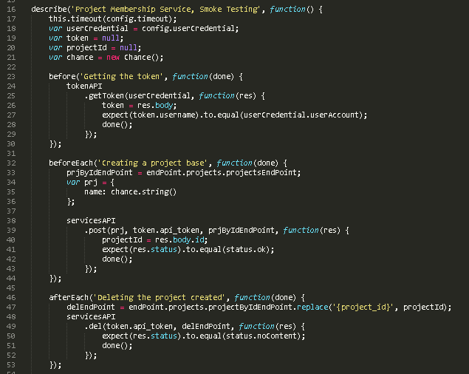
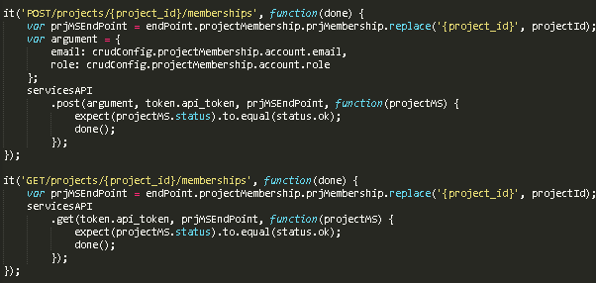
Automation Smoke Tests

Slide 34
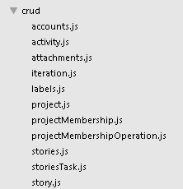
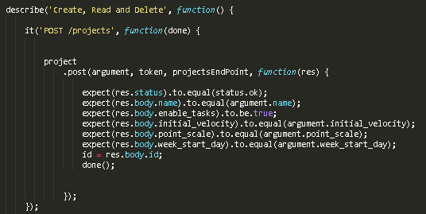
Automation CRUD Tests
Correct inputs, return expected outputs

Slide 35
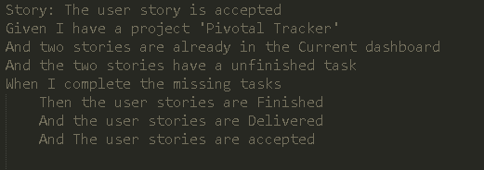
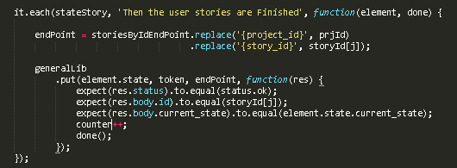
Automation BDT Tests
The Scenario tests should cover all of the business logic

Slide 36
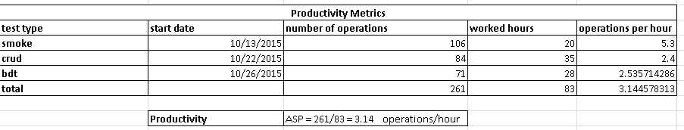
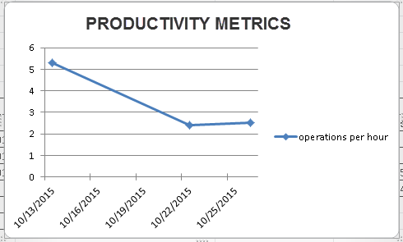
Metrics

Slide 37
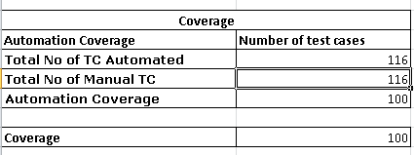
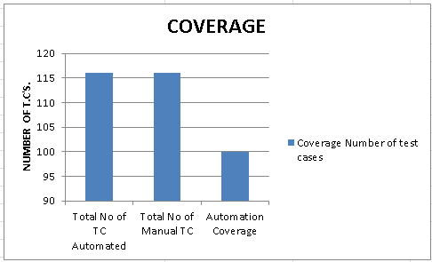
COVERAGE

Slide 38

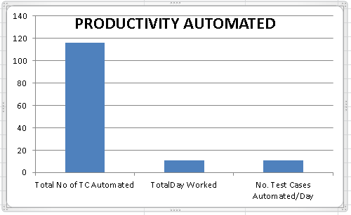
PRODUCTIVITY AUTOMATED

Slide 39
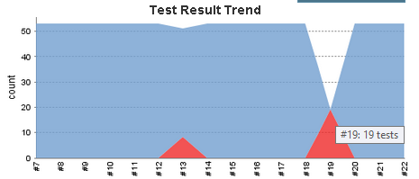

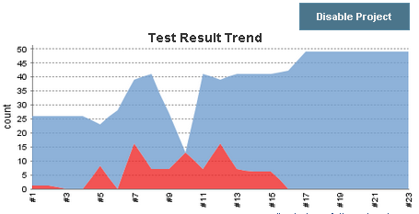

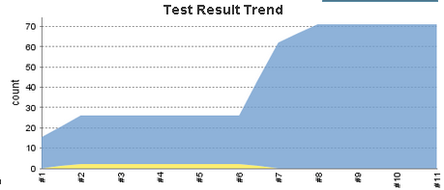

Jenkins Chart

Slide 40

QUESTIONS?

